Slide 1
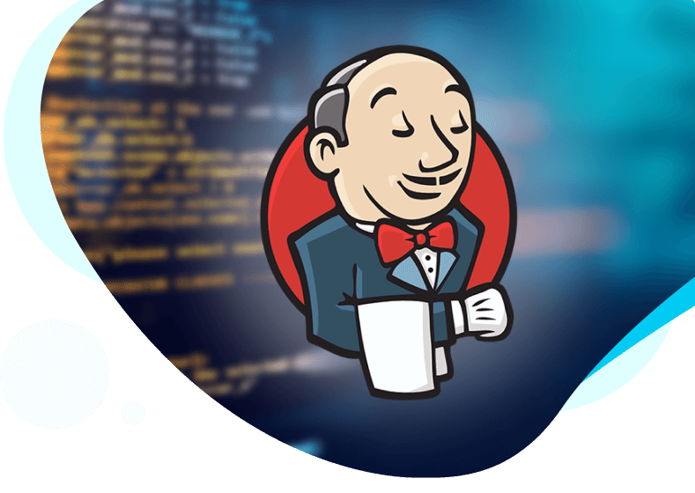
Advanced Jenkins
Presenter
Mohammad Anees Alam
Notes:
1

Slide 2





Today's Agenda !!
Jobs & Files in Jenkins
File Structure & its key fields
Upstream & Downstream jobs
Hands-on Activity
CI best practices & optimization
Notes:
2

Slide 3
Understanding Jenkins Job Types
Freestyle Jobs
Pipeline Jobs
Multi-branch Jobs
Freestyle jobs in Jenkins are the simplest and fundamental type of job. They offer a user-friendly interface for setting up and executing automation tasks.
Pipeline jobs in Jenkins enable the creation of CI/CD workflows through code, providing the flexibility to handle complex automation processes.
Multibranch pipelines automatically generate Jenkins jobs for every branch in a Git repository, streamlining the management of multiple branches in a single pipeline configuration.
Use Cases in DevOps
Use Cases in DevOps
Use Cases in DevOps
  Running custom scripts (e.g., Shell, Python)
  Automating CI/CD workflows
  Running different CI/CD pipelines for feature branches
  Running tests and deployments in multiple environments
  Deploying a basic application
  Automatically testing code in pull requests
  Running system maintenance tasks
  Integrating with cloud platforms (AWS, Azure, GCP)
  Supporting multiple environments (e.g., Dev, QA, Prod)
Notes:
3

Slide 4

Scripted Pipeline
A Scripted Pipeline provides a highly adaptable approach to defining CI/CD workflows in Jenkins by leveraging Groovy scripting for advanced customization and control.
Use-cases:
1
Groovy Scripting
2
Dynamic Execution
3
Third-Party Integration
Define CI/CD workflows with Groovy for flexibility.
Customize workflows with loops and conditional logic.
Integrate with AWS, Terraform, and Ansible.
Notes:
4

Slide 5
Key differences btw Scripted pipeline & Declarative pipeline
# SCRIPTED PIPELINE
node {
try {
stage('Checkout') {
checkout scm
}
stage('Build') {
echo 'Building the project...'
sh 'mvn clean package'
}
stage('Test') {
echo 'Running tests...'
sh 'mvn test'
}
if (env.BRANCH_NAME == 'main') {
stage('Deploy') {
echo 'Deploying application...'
sh './deploy.sh'
}
}
} catch (Exception e) {
echo "Pipeline failed: ${e.getMessage()}"
currentBuild.result = 'FAILURE'
}
}
# DECLARATIVE PIPELINE
pipeline {
agent any
stages {
stage('Checkout') { steps { checkout scm } }
stage('Build') { steps { sh 'mvn clean package' } }
stage('Test') { steps { sh 'mvn test' } }
stage('Deploy') {
when { branch 'main' }
steps { sh './deploy.sh' }
}
}
post { failure { echo 'Pipeline failed!' } }
}
  Use Declarative Pipeline for simplicity, structure, and built-in validation in standard CI/CD workflows.
  Use Scripted Pipeline for complex logic, dynamic execution, and advanced Groovy scripting when more control is needed.
Notes:
5

Slide 6
Key fields to observe in the script!
1
pipeline:
2
agent:
3
environment:
Defines the entire pipeline.
Specifies where the pipeline runs (any for any available agent).
Sets environment variables (e.g., APP_ENV).
4
stages:
5
steps:
6
post:
Contains individual stage blocks for steps.
Defines commands to execute within a stage
Defines actions after pipeline execution (e.g., success or failure).
Notes:
6

Slide 7
Comparison:
Feature
Scripted Pipeline
Declarative Pipeline
Syntax
Imperative (free-form)
Structured (block-based)
Branch Handling
Explicit if condition
when { branch 'main' }
Error Handling
Manual try-catch
Built-in post block
Readability
More flexible, but harder to read
More readable and standardized
Complex Logic
Better suited for complex workflows
Best for simple and standard workflows
Notes:
7

Slide 8
Jenkins File Structure
  Jenkins stores data under the default directory: /var/lib/jenkins/
secrets/
config.xml
jobs/
logs/
Holds encrypted credentials & API tokens.
Stores global Jenkins configurations.
Contains individual job configurations.
Contains Jenkins logs for troubleshooting.
1
2
3
4
5
6
7
8
Jenkinsfile
plugins/
workspace
users/
Defines Pipeline as Code in Groovy.
Stores installed Jenkins plugins.
Stores temporary build files during execution.
Stores user account data.
Notes:
8

Slide 9
config.xml Vs .yml
.yml files (GitHub actions)
Feature
config.xml
Purpose
Stores Jenkins job configurations
Defines CI/CD workflows in GitHub Actions
Pipeline Type
Used mainly for Freestyle Jobs (not Pipeline jobs)
Defines CI/CD workflows similar to Jenkins Pipelines.
Execution Trigger
Jobs can be triggered by Jenkins (manually, webhooks, or scheduled builds)
Workflows are triggered by GitHub events (push, pull request, cron schedules, etc.)
Modification Method
Usually modified via Jenkins UI or manually in the file system
Edited directly in GitHub
Notes:
9

Slide 10
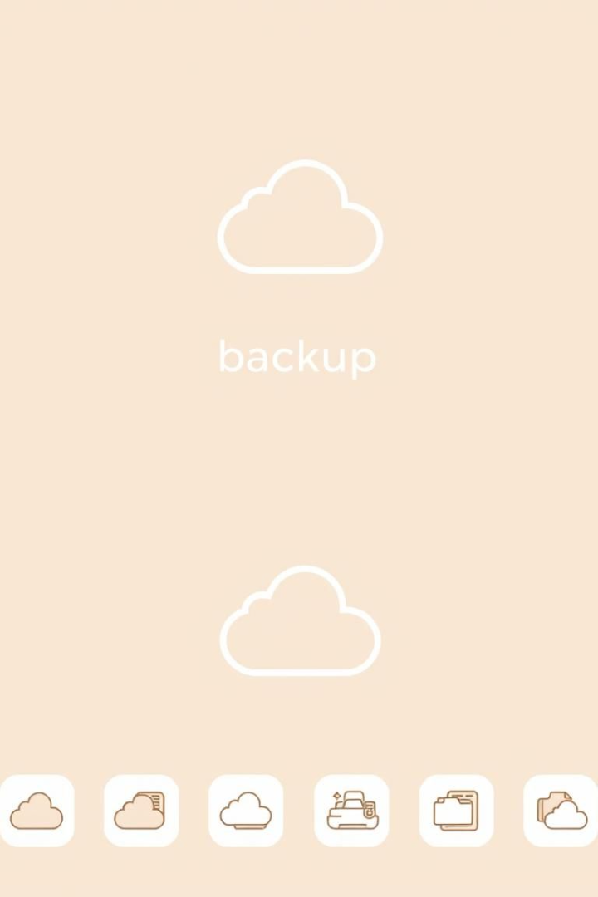




Backup and Restore Jenkins
Backup Configuration
Create a backup of essential Jenkins files.
Restore Configuration
Restore Jenkins from a backup file.
Automate Backups
Schedule daily backups with a cron job.
Notes:
10

Slide 11
Upstream & Downstream jobs
In Jenkins, upstream and downstream jobs refer to the relationship between jobs in a pipeline or workflow:
Upstream jobs
Downstream jobs
This is a job that triggers another job (the downstream job) upon completion. It typically runs first and passes its results or artifacts to the downstream job.
This is a job that is triggered by an upstream job. It depends on the upstream job's execution and often uses the output or artifacts from the upstream job to perform further tasks.
For example:
  An upstream job might compile code and run unit tests.
  A downstream job might take the compiled code and deploy it to a staging environment.
This relationship allows for "execution of sequential automation workflows" in Jenkins.
Notes:
11

Slide 12
Hands-on Activity
Let's set up two separate pipelines in Jenkins and execute them sequentially to explore the concept of upstream and downstream jobs.
1
Create 2 Jenkins Pipeline Jobs
upstream job & downstream job.
2
Run Upstream Job
Set the trigger of downstream job after successful execution.
3
Check the console output
Verify how the downstream job got triggered while upstream job is being executed.
Notes:
12

Slide 13
CI Best Practices
Modular Pipelines
1
Use Shared Libraries for reusability.
Reduce Build Times
2
Use caching and parallel stages.
Automated Rollbacks
3
Handle failures with post conditions.
Notes:
13

Slide 14
GitHub Actions vs. Jenkins
Feature
GitHub Actions
Jenkins
Type
Cloud-based CI/CD
Self-hosted CI/CD
Installation
No installation
Manual installation
Cost
Free for public repos
Free, infrastructure costs
Ease of Use
Simple YAML-based workflows
UI-based with Groovy pipelines
Integration
Native GitHub support
Supports various SCMs (GitHub, GitLab, Bitbucket)
Scalability
Runs on GitHub-hosted or self-hosted runners
Requires own infrastructure for scaling
Notes:
14

Slide 15
The end of Continuous Integration!
Next stop .... Testing frameworks.

